Slide 1

Arduino Programming For ESD
By Md.Dedarul Hasan

Slide 2
Arduino Programming Basic
Introduction
Programming Concept
Digital And Analog Input Receive
Use Of Condition
Use Of Loop
Use Of Array
LCD Display Simulation With Arduino
Servo Motor Simulation With Arduino
Extra Work
Conclusions

Slide 3
Introduction
Microcontroller
A microcontroller can be considered a self-contained system with a processor, memory and peripherals and can be used as an embedded system.The majority of microcontrollers in use today are embedded in other machinery, such as automobiles, telephones, appliances, and peripherals for computer systems.Microcontrollers are designed for embedded applications, in contrast to the microprocessors used in personal computers or other general purpose applications consisting of various discrete chips.
Microcontroller Configuration of Arduino: ATmega328P (used on most recent boards)-Digital I/O Pins 14 (of which 6 provide PWM output), Analog Input Pins 6 (DIP) or 8 (SMD), DC Current per I/O Pin 40 mA, Flash Memory-32 KB, SRAM -2 KB, EEPROM-1KB

Slide 4
A microcontroller is a single integrated circuit, commonly with the following features:
central processing unit – ranging from small and simple 4-bit processors to complex 32-bit or 64-bit processors
volatile memory (RAM) for data storage
ROM, EPROM, EEPROM or Flash memory for program and operating parameter storage
discrete input and output bits, allowing control or detection of the logic state of an individual package pin
serial input/output such as serial ports (UARTs)
other serial communications interfaces like I²C, Serial Peripheral Interface and Controller Area Network for system interconnect
peripherals such as timers, event counters, PWM generators, and watchdog
clock generator – often an oscillator for a quartz timing crystal, resonator or RC circuit
many include analog-to-digital converters, some include digital-to-analog converters
in-circuit programming and in-circuit debugging support

Slide 5
Microprocessor
Microprocessor has only a CPU inside them in one or few Integrated Circuits. Like microcontrollers it does not have RAM, ROM and other peripherals. They are dependent on external circuits of peripherals to work. But microprocessors are not made for specific task but they are required where tasks are complex and tricky like development of software’s, games and other applications that require high memory and where input and output are not defined. It may be called heart of a computer system.
Parts of CPU-
ALU
REGISTER
COUNTER
FLAG
BUS
PROGRAM COUNTER

Slide 6
What is Arduino?
Arduino refers to an open-source electronics platform or board and the software used to program for embedded system. Arduino is designed to make electronics more accessible to artists, designers, hobbyists and anyone interested in creating interactive objects or environments.
Component Of Arduino :
Microcontroller-ATmega328P
Power (USB / Barrel Jack)
Pins (5V, 3.3V, GND, Analog, Digital, PWM, AREF)
Reset Button.
Power LED Indicator.
TX RX LEDs.
Voltage Regulator.

Slide 7
Different type of Arduino :
Arduino Uno
Arduino Due
Arduino Mega
Arduino Leonardo
LilyPad
Nano
Mini
Mini Pro
BT
Advantages & Disadvantages of Arduino :
Not much knowledge required to get started.
Fairly low cost, depending on shields you need.
Lots of sketches and shields available.
No external programmer or power supply needed.

Slide 8
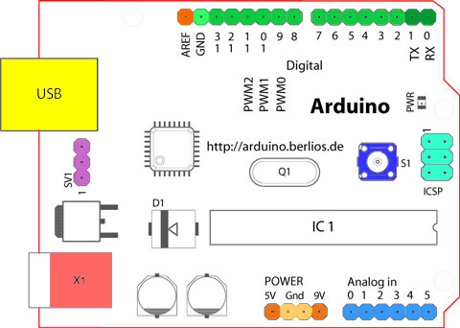
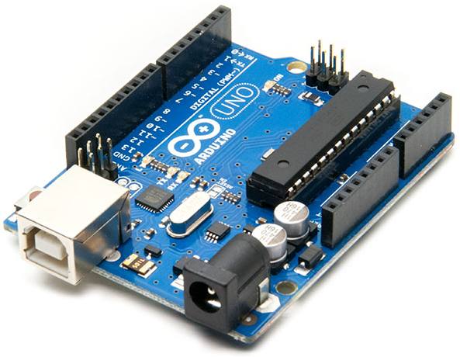
Description of Arduino PORT or PINS :

Slide 9
Description of Arduino PORT or PINS :
Analog Reference pin (orange)
Digital Ground (light green)
Digital Pins 2-13 (green)
Digital Pins 0-1/Serial In/Out - TX/RX (dark green) - These pins cannot be used for digital i/o (digitalRead and digitalWrite) if you are also using serial communication (e.g. Serial.begin).
Reset Button - S1 (dark blue)
In-circuit Serial Programmer (blue-green)
Analog In Pins 0-5 (light blue)
Power and Ground Pins (power: orange, grounds: light orange)
External Power Supply In (9-12VDC) - X1 (pink)
Toggles External Power and USB Power (place jumper on two pins closest to desired supply) - SV1 (purple)
USB (used for uploading sketches to the board and for serial communication between the board and the computer; can be used to power the board) (yellow)

Slide 10
Basic Programming Concept
Arduino uses its own programming language, which is similar to C++. However, it's possible to use Arduino with Python or another high-level programming language like C, Java. In fact, platforms like Arduino work well with Python, especially for applications that require integration with sensors and other physical devices

Slide 11
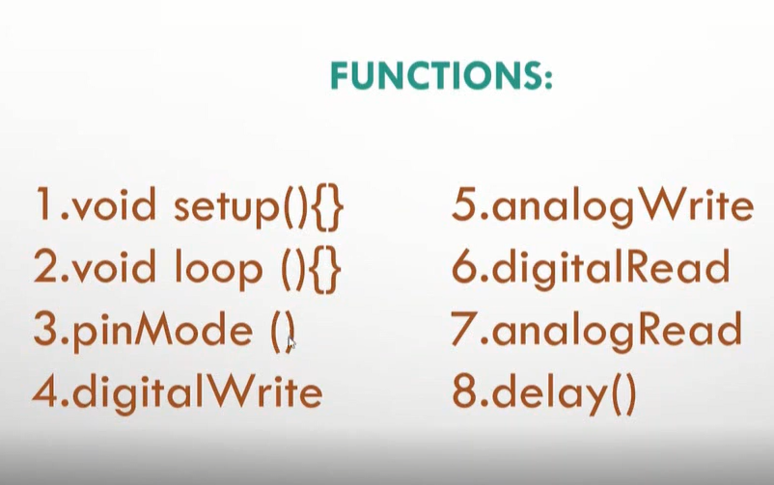
Useful Functions For Arduino:

Slide 12
Void setup() Function :
Void setup is technically a function that you create at the top of each program. Inside the curly brackets is the code that you want to run one time as soon as the program starts running. You set things like pinMode in this section. The loop is another function that Arduino uses as a part of its structure.
Declaration :
Void setup() {
//write code here
}
Void Loop() Function :
This is where the bulk of your Arduino sketch is executed. The program starts directly after the opening curly bracket ( } ), runs until it sees the closing curly bracket ( } ), and jumps back up to the first line in loop() and starts all over.
Declaration :
Void loop(){
//write code here
}

Slide 13
pinMode() Function :
The pinMode() function is used to configure a specific pin to behave either as an input or an output. It is possible to enable the internal pull-up resistors with the mode INPUT_PULLUP. Additionally, the INPUT mode explicitly disables the internal pull-ups.
Declarations :
pinMode(pin-number, OUTPUT); // pin as output
pinMode(pin-number, INPUT); //pin as input
digitalWrite() Function :
Write a HIGH or a LOW value to a digital pin. If the pin has been configured as an OUTPUT with pinMode() , its voltage will be set to the corresponding value: 5V (or 3.3V on 3.3V boards) for HIGH , 0V (ground) for LOW.
Declaration :
digitalWrite(pin number, HIGH); //set the pin as high
digitalWrite(pin number, LOW); //set the pin as low

Slide 14
digitalRead () Function :
This function use to read the value from a specified digital pin, either HIGH or LOW. Syntax: digitalRead(pin) Where, pin: the number of the digital pin you want to read (int).
Declaration :
digitalRead (pin-number) ; //pin value should be HIGH/LOW as output
analogWrite () Function :
The analogWrite Arduino command is used to update the status of analog pins and also used to address the PWM pins on the board. The PWM pins are 8-bit pins, terming that you can set the duty cycle somewhere between 0 -255.Writes an analog value (PWM wave) to a pin. Can be used to light a LED at varying brightnesses or drive a motor at various speeds.
Declaration :
analogWrite(pin number, 0); // set low analog value
analogWrite(pin number, 255); //set high analog value

Slide 15
analogRead() Function :
Reads the value from the specified analog pin. The Arduino board contains a 6 channel (8 channels on the Mini and Nano, 16 on the Mega), 10-bit analog to digital converter. This means that it will map input voltages between 0 and 5 volts into integer values between 0 and 1023.
Declaration :
analogRead(pin Number); //it returns high or low
delay() Function :
The way the delay() function works is pretty simple. It accepts a single integer (or number) argument. This number represents the time (measured in milliseconds). The program should wait until moving on to the next line of code when it encounters this function.
Declaration :
delay(1000); //delay for 1000ms

Slide 16
Tools & Installations :
To write code we will use arduino development tools by installing it ;
-https://www.arduino.cc/en/main/software
We can also use Tinkarcad.com online autodesk software to code & simulations for arduino both.
-https://www.tinkercad.com/dashboard?type=circuits&collection=designs

Slide 17
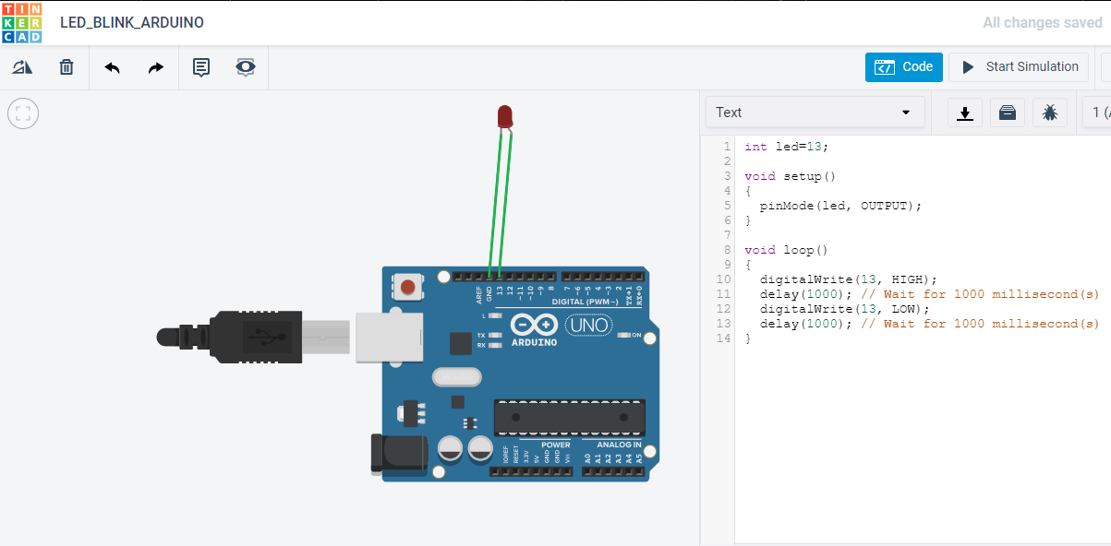
LED blink Program With Arduino :

Slide 18
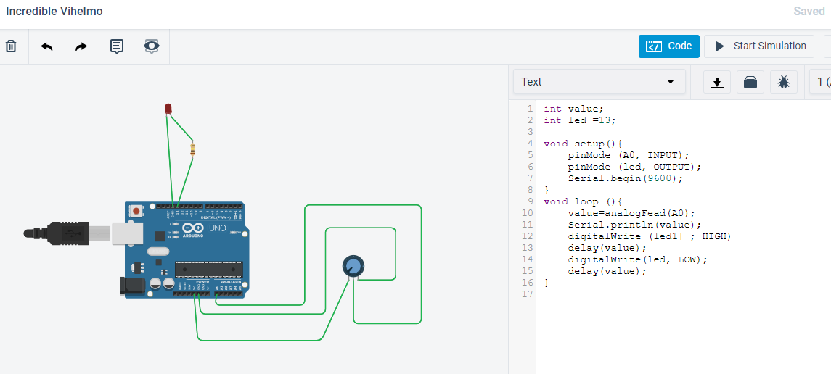
LED blinks With Contrast :

Slide 19
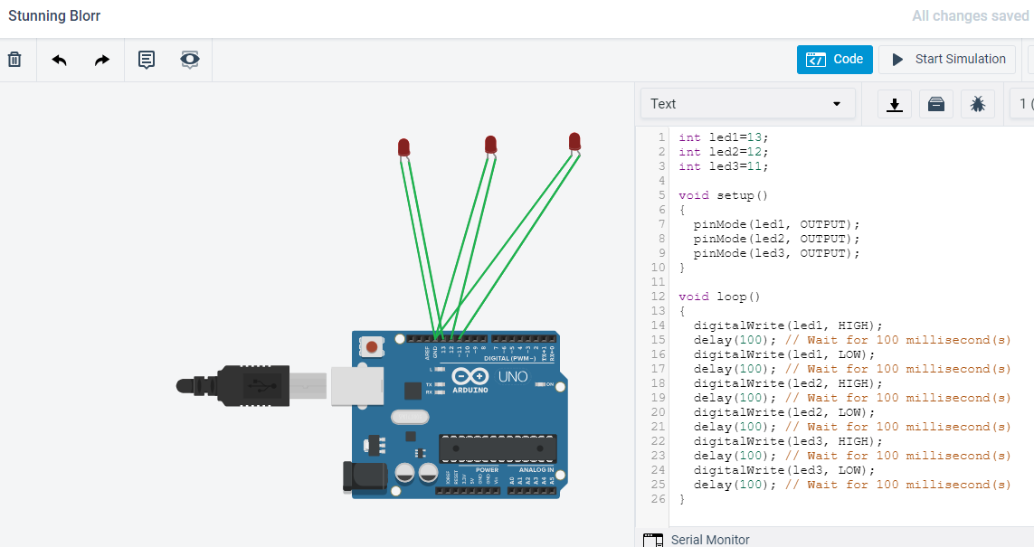
Multiple LED Blinks :

Slide 20
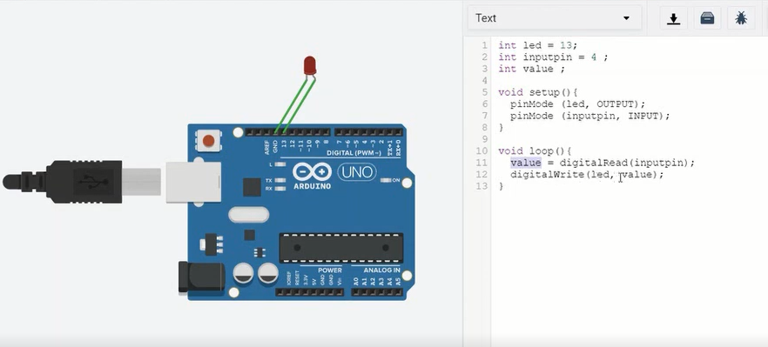
Digital And Analog Input Receive
Digital Input Receive :

Slide 21
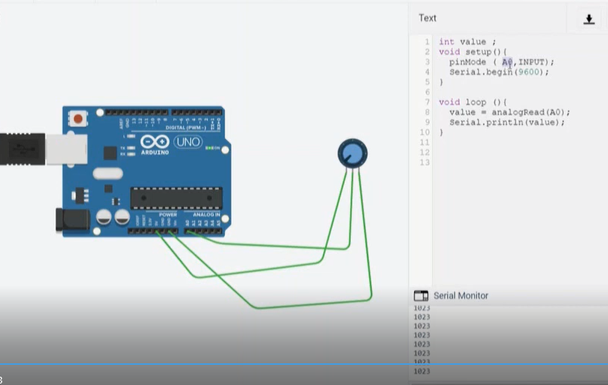
Analog Input Receive :

Slide 22
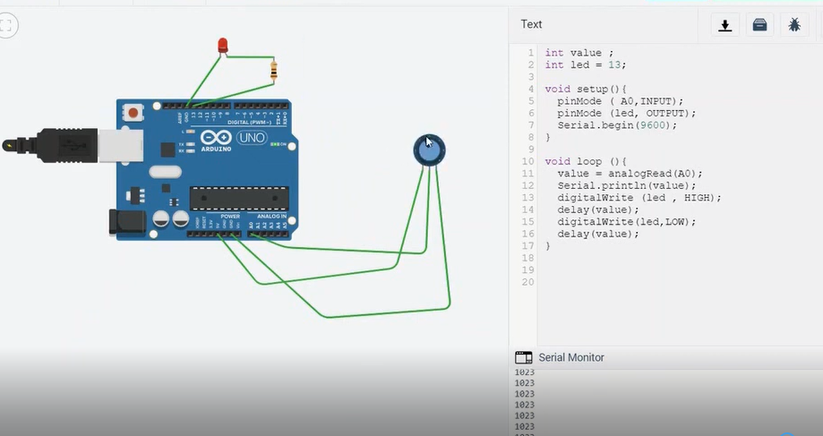
Analog Input Delay :

Slide 23
Use Of Condition
condition : each time through the loop, condition is tested; if it's true , the statement block, and the increment is executed, then the condition is tested again. When the condition becomes false , the loop ends. increment : executed each time through the loop when condition is true .
If ...else condition, boolean condition etc

Slide 24
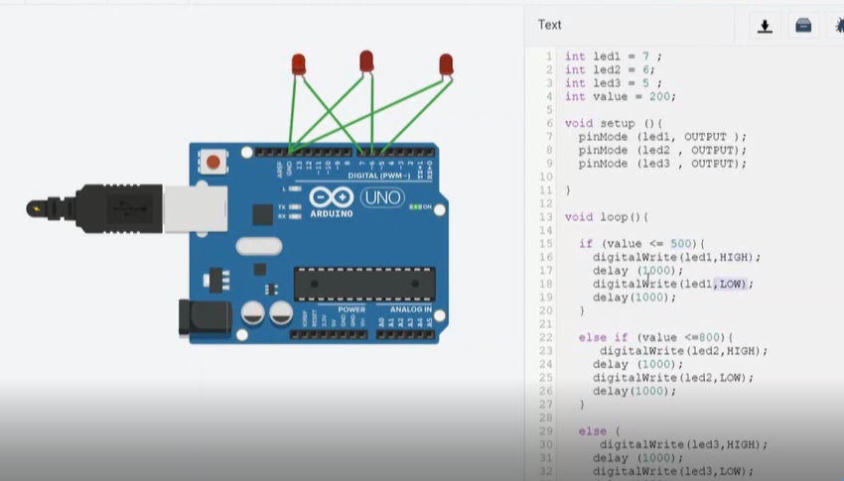
LED Blink Using Condition :

Slide 25
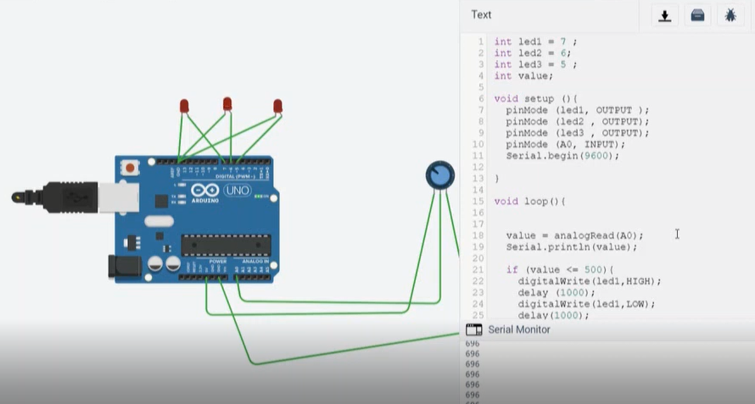
Condition With Analog Value :

Slide 26
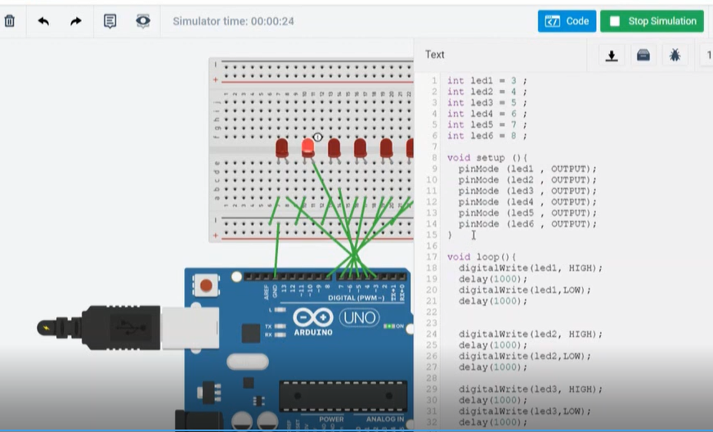
Multiple LED Blink Without Loop :

Slide 27
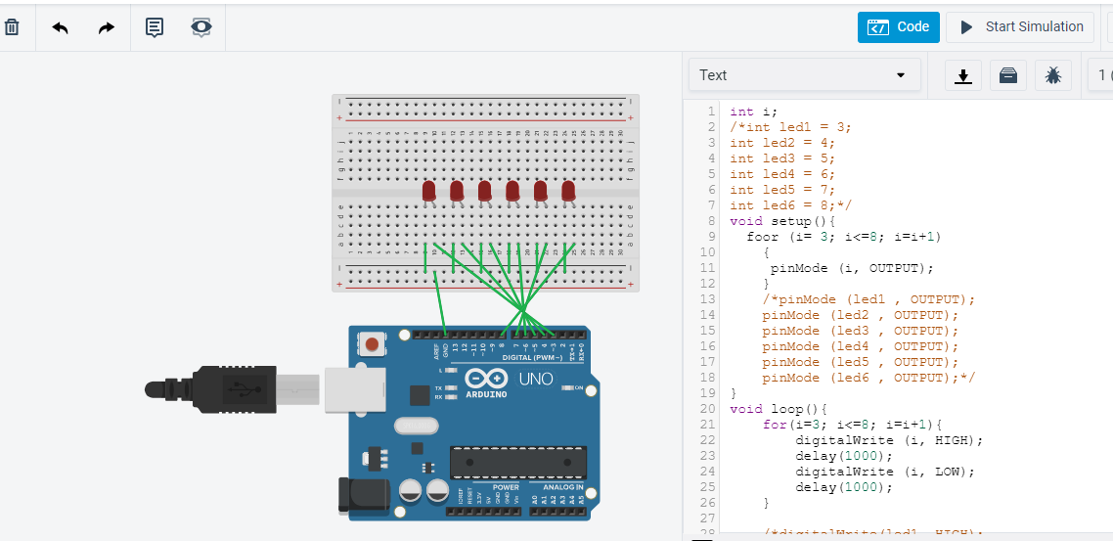
Use Of Loop
Multiple LED Blink Using For Loop :

Slide 28

Multiple LED Blink Using For Loop :

Slide 29
Use Of Array
Array :
An array is a consecutive group of memory locations that are of the same type. To refer to a particular location or element in the array, we specify the name of the array and the position number of the particular element in the array.
All of the methods below are valid ways to create (declare) an array. int myInts[6]; int myPins[] = {2, 4, 8, 3, 6}; int mySensVals[6] = {2, 4, -8, 3, 2}; char message[6] = "hello"; You can declare an array without initializing it as in myInts. In myPins we declare an array without explicitly choosing a size.

Slide 30
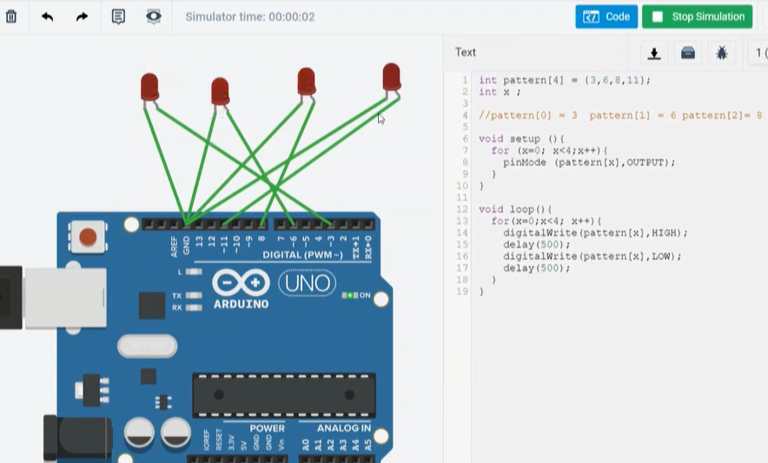
LED Blink Using Array :

Slide 31
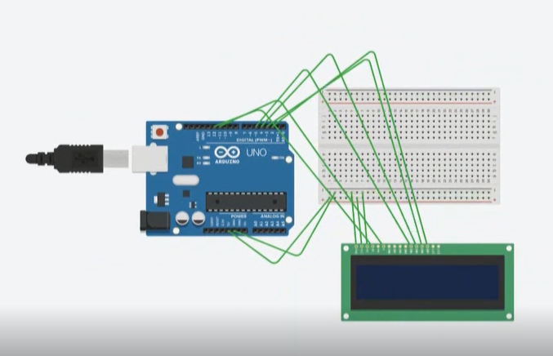
LCD Display Simulation With Arduino

Slide 32
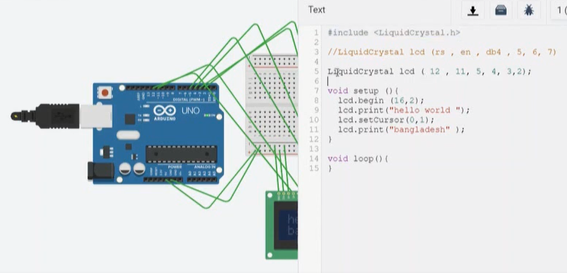
LCD Display Using Arduino :

Slide 33
Servo Motor Simulation With Arduino
A servomotor is a rotary actuator or linear actuator that allows for precise control of angular or linear position, velocity and acceleration. It consists of a suitable motor coupled to a sensor for position feedback.

Slide 34
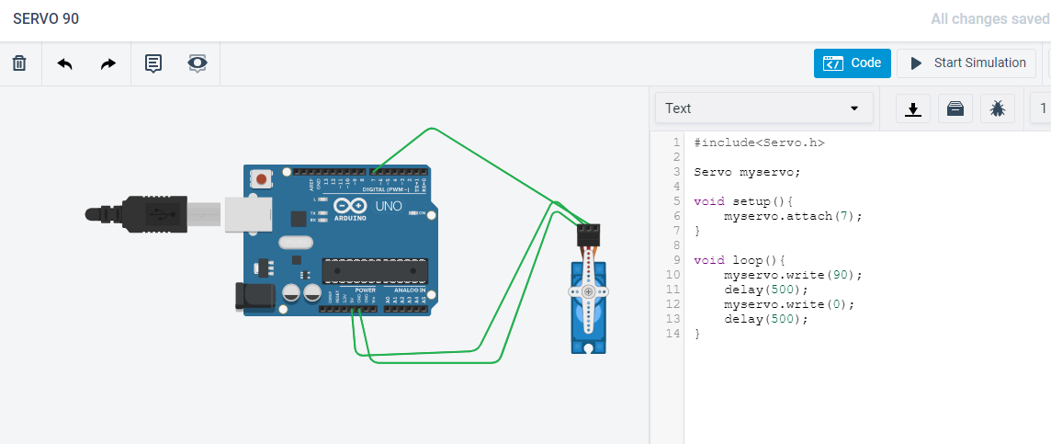
Servo Motor 90 Degree Rotation :

Slide 35
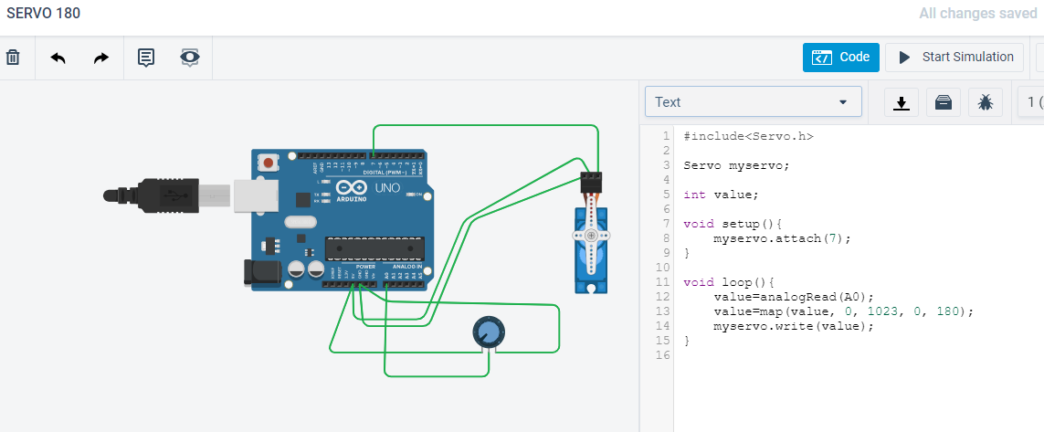
Servo Motor 180 Rotation :

Slide 36
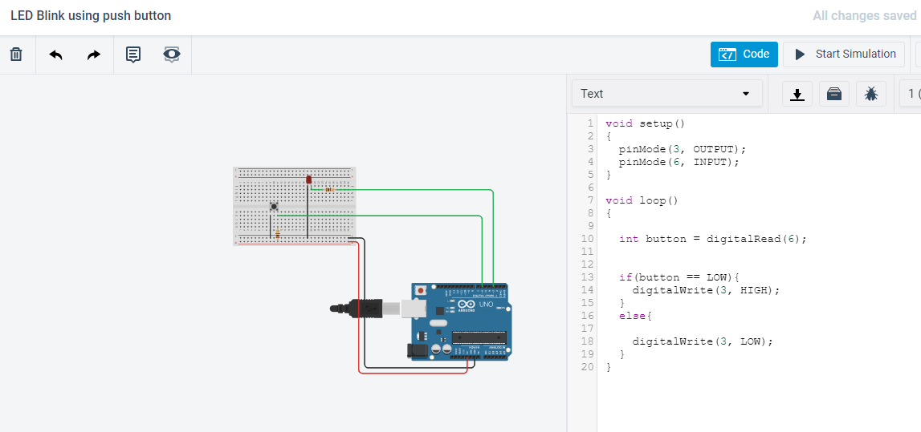
Extra Work : LED Blink Using Push Button

Slide 37
Conclusions :
As a beginner with arduino i am pleased to learn using Tinkarcad.com.Wishing that ,the feedback by practice i’ll be able to be an expert with that embedded system design.Next, I shall go for expert and advanced level using arduino.

Slide 38
Thanks

